Slide 1
EML, KNB, and ERDDAP
Bob Simons
DOC / NOAA / NMFS / SWFSC / ERD
Monterey, CA
bob.simons@noaa.gov
(Special thanks to Margaret O'Brien)
Notes:
[Bob: talk fast!]

Slide 2
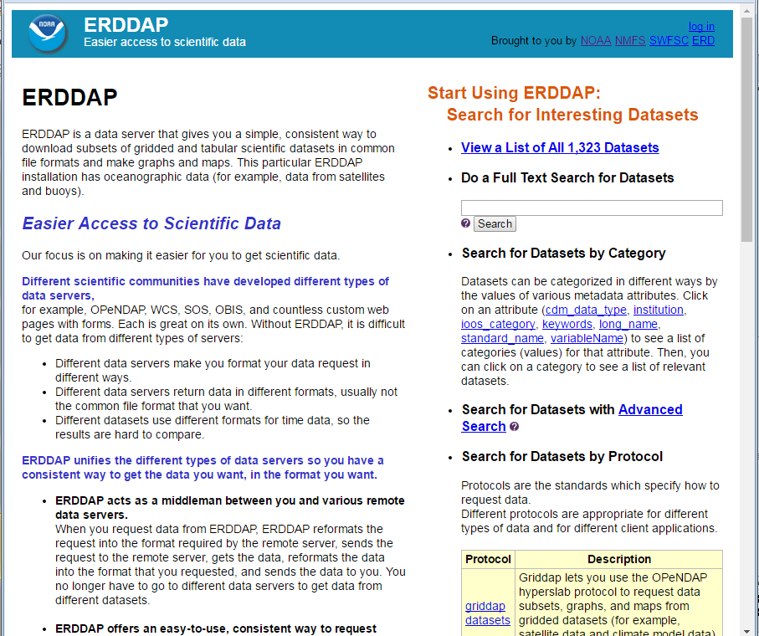
Notes:
Let's start with ERDDAP.
ERDDAP is software that runs on a server.
It makes a web site for distributing data.
ERDDAP's goal is to give users easier access to scientific data.
ERDDAP is reusable, Free, and Open Source.
It has been installed at more than 60 institutions in at least 10 countries
and is on NOAA's list of recommended data servers.

Slide 3
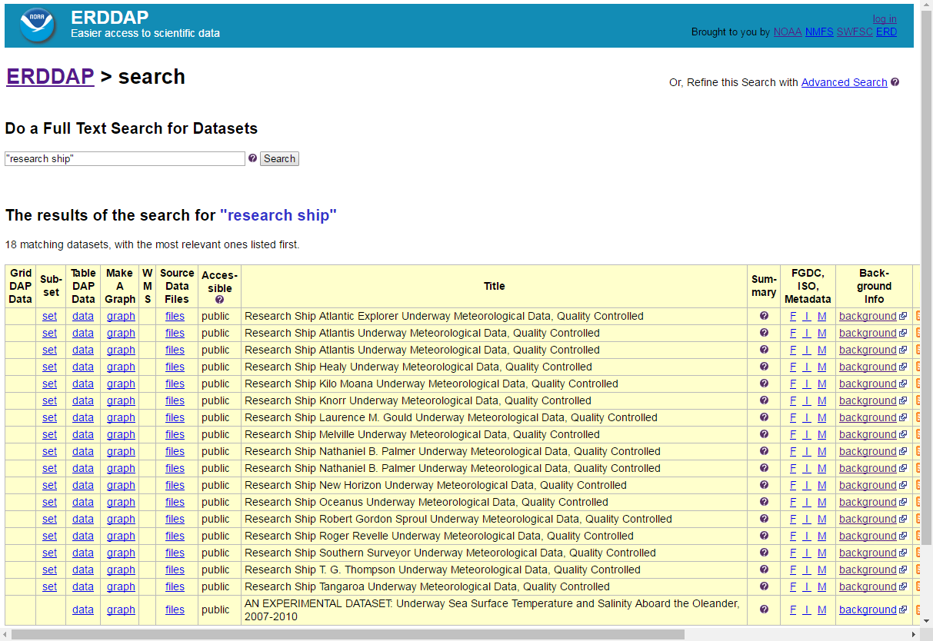
Notes:
Here, I searched for the phrase "research ship" in the search box.
All of the search options lead to a list of datasets,
showing ways you can access the dataset (on the left)
and some information about the dataset (on the right).

Slide 4
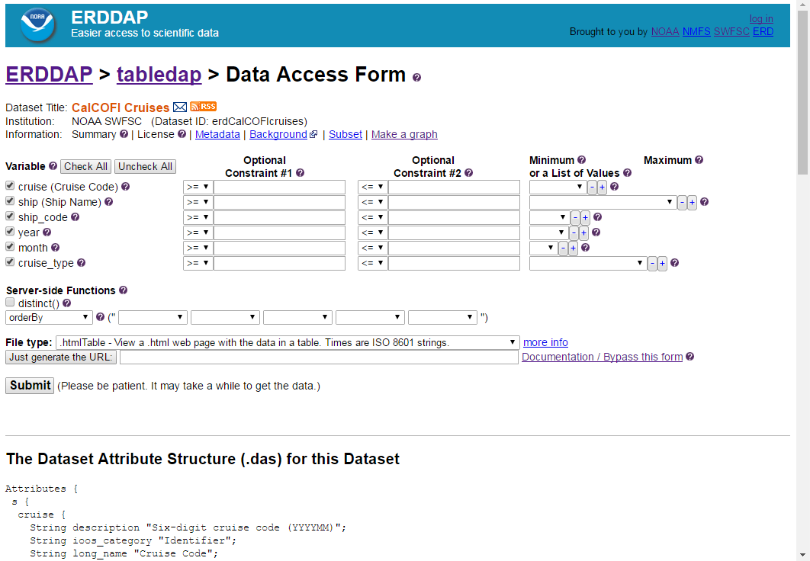
Notes:
The "data" links lead to Data Access Form
so you can request a subset of data.
A unique feature of ERDDAP is that you can specify the response file type
(any of 20 different types)
in order get the data in the format that is easiest for you to work with.

Slide 5
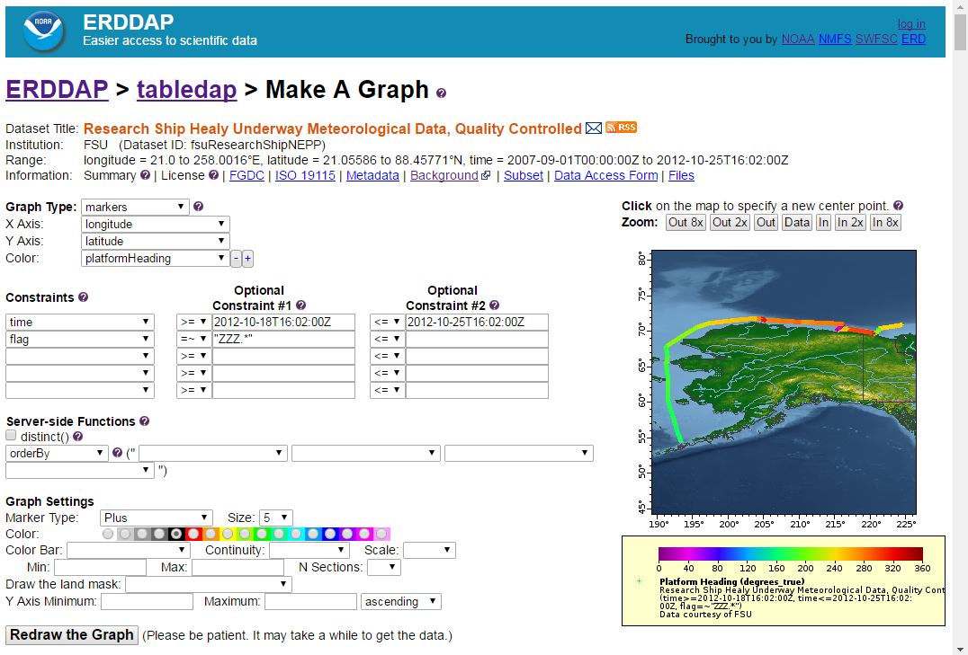
Notes:
There are also Make A Graph web pages for all datasets,
so you can create custom graphs and maps.

Slide 6
What ERDDAP looks like to a user:
ERDDAP
Your Favorite Client Software
Notes:
For a users point of view, ERDDAP is a data server
that gives users a simple, consistent way
to download subsets of gridded and tabular scientific datasets
and make graphs and maps.
Because ERDDAP returns data in the file format that the user specifies,
it is easy for users to get the data into their favorite client software.

Slide 7
What ERDDAP looks like to a data provider:
OBIS
SOS
THREDDS
Hyrax
ERDDAP
...
3
Database
ERDDAP
Files
2
1
4
Your Favorite Client Software
Notes:
From a data providers point of view,
ERDDAP is acting as a middleman that can get data
from a wide variety of local and remote data sources
and offer them to users in a consistent way
that hides the details of the actual source.
When a user sends a standardized request for data to ERDDAP,
ERDDAP translates it into the request format needed by the actual source, for example, a database.
ERDDAP then gets the response from the source, in whatever format that is,
and reformats the data into the file format that the user has requested.

Slide 8
Acting as a middleman allows ERDDAP to
Improve each dataset's metadata.
Generate ISO 19115 metadata.
Standardize the format of time data.
Provide a unified way for users to search for datasets.
Offer a standard way to request data from any dataset.
Let users specify the response file format.
Make life easier for data providers and for users.
Notes:
Acting as a middleman between the user and the data source allows ERDDAP to have several useful features, including:
ERDDAP has a system to modify and add to each dataset's existing metadata.
Metadata is the who, what, when, where, why, and how
information about each dataset that helps users understand the dataset.
Since the metadata has been improved,
ERDDAP can generate ISO 19115 metadata files,
which is the format required for ingest into NOAA's and
the US Governments data catalogs,
which is one of the PARR (Public Access to Research Results) requirements.
ERDDAP standardizes the format of time data.
This saves the user from the horrendous problem
of having to deal with the multitude of existing date time formats.
This makes it much easier to compare data from different datasets.
ERDDAP provides a unified way for users to search for datasets
via Google-like, full-text search,
via category browsing (aka faceted search),
and via advanced search, which combines all search options.
ERDDAP offers a standard way to request a subset of the data from any dataset
via web applications -- web pages with forms for humans
and via web services -- where one RESTful URL specifies the entire request.
Making data accessible via web services are another part of the PARR requirements.
ERDDAP lets users specify the response file format, which ERDDAP makes on-the-fly.
So users can get a file format that is easy for them to work with
So users don't have to waste their time converting data from one format to another.
There are about 20 different data file types
and also some image file types, so users can request customized maps and graphs.
All of the features are designed to make life easier for data providers and for users.

Slide 9
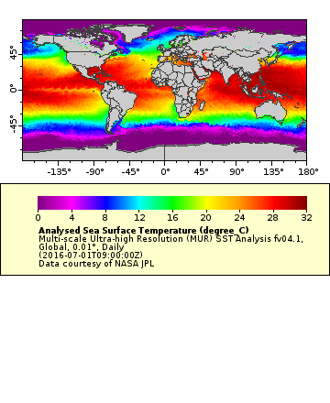
Gridded Data
A RESTful URL specifies an entire request: dataset, response file type, subset: http://coastwatch.pfeg.noaa.gov/erddap/griddap/jplMURSST41.html ?analysed_sst[(2016-07-01T09:00:00Z)][(-89.99):(89.99)][(-179.00):(180)]
Special file types: .html (Data Access Form), .graph (graph form), .fgdc, .iso19115, .das, .dds
Data file types: .asc, .csv, .esriAscii, .json, .htmlTable, .mat, .nc, .odvTxt, .tsv, ...
Image file types: .geotif, .kml, .pdf, .png, .transparentPng
Notes:
ERDDAP deals with datasets as either multidimensional, gridded data, or as a database-like table of data.
In both cases, a RESTful URL ...
... so users can make customized graphs and maps.

Slide 10
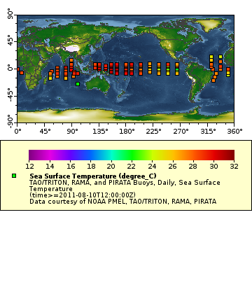
Tabular Data
A RESTful URL specifies an entire request: dataset, response file type, subset: http://coastwatch.pfeg.noaa.gov/erddap/tabledap/pmelTaoDySst.html ?longitude,latitude,T_25,time&time=2011-08-10T12:00:00Z
Special file types: .html (Data Access Form), .graph (graph form), .fgdc, .iso19115, .das, .dds, .subset
Data file types: .asc, .csv, .esriCsv, .htmlTable, .geoJson, .json, .mat, .nc, .ncCF, .ncCFMA, .odvTxt, .tsv, .xhtml, ...
Image file types: .geotif, .kml, .pdf, .png, .transparentPng
Notes:
Similarly, for tabular datasets, a RESTful URL ...

Slide 11
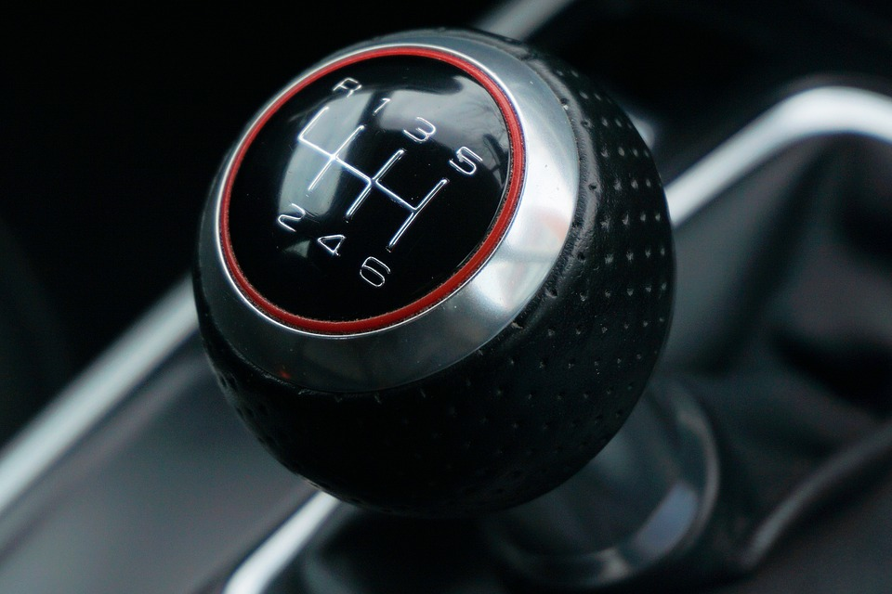
Notes:
Let's shift gears.

Slide 12
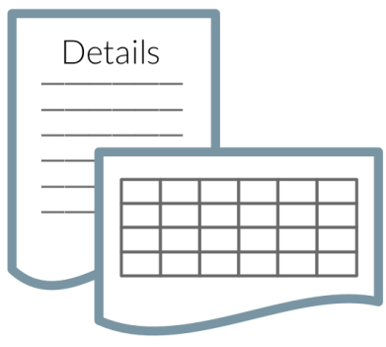
Knowledge Network for Biocomplexity (KNB)
An NSF-funded data repository for ecologists and environmentalists
A DataONE (NSF) Member Node
Downloadable: EML metadata files and tabular data files
https://knb.ecoinformatics.org/#
Notes:
That's an image from their website!

Slide 13
Ecological Metadata Language (EML)
is a great XML-based metadata language for describing ecological tabular scientific datasets.
It is standardized, mature, well-documented.
The XML is easy for a human to read and understand
Indentation that is just right (cough, not like OGC, cough)
There are tools to help users
It has XML tags for a full description of the variables
Everything is very well done!
https://knb.ecoinformatics.org/#external//emlparser/docs/index.html

Slide 15
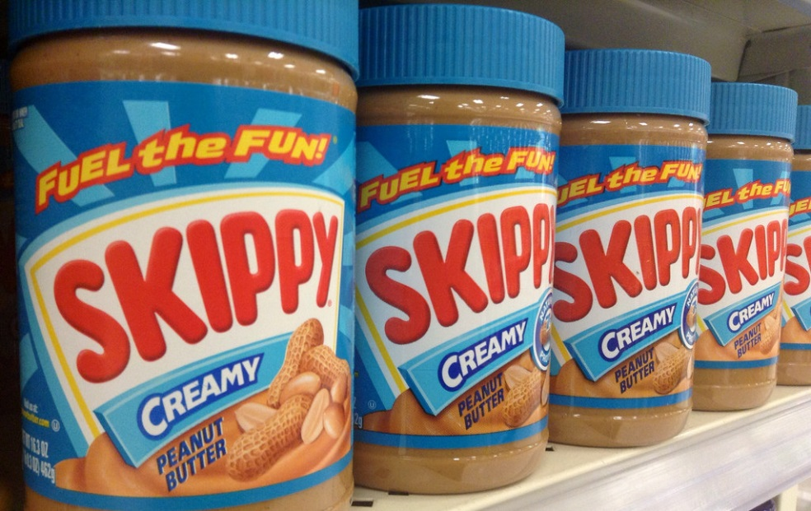
What if we combined ERDDAP and EML?!
+

Slide 16
GenerateDatasetsXml
A tool that comes with ERDDAP
It generates the description of a dataset that ERDDAP needs to serve the datasets.
New EDDTableFromEML option
New EDDTableFromEMLBatch option
https://coastwatch.pfeg.noaa.gov/erddap/download/EDDTableFromEML.html

Slide 17
It works great!
Added 200 SBC LTER datasets in 20 minutes!
The EML has all the information ERDDAP needs. That was key. EML succeeds brilliantly!
The EML always a link to the data file. That was key. EML succeeds brilliantly!
The data files have diverse but usable formats.
The date time formats are not well described in the EML, but can be determined.
I added other new ERDDAP features, e.g., timezones.
The conversion succeeds with about 90% of EML files. The rest are fixable (e.g., make a date+time variable).

Slide 18
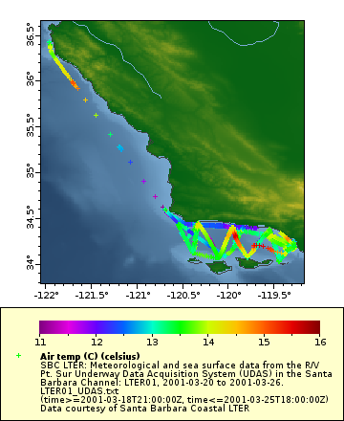
Advantages of having the datasets in ERDDAP:
Users can now do Google-like searches for datasets of interest.
Time is now formatted consistently.
Users can now see subsets of the dataset and make custom graphs and maps without downloading the data.
Data are now available in a consistent file format of the user's choice.
ERDDAP generates ISO 19115 XML for inclusion in data.gov catalog.
Interactive - not download, parse, then explore.
Notes:
...
Mostly, the data is now accessible in an interactive way ...

Slide 19
Public Access to Research Results (PARR) Requirements
Government funded data shall be publicly and freely:
Discoverable via a catalog (data.noaa.gov -> data.gov)
Understandable via metadata
Accessible via a web service (e.g., ERDDAP / DAP) (not just downloadable files or a shopping cart)
Your data available within one year (by last year ASAP!)
ERDDAP can help with all of these requirements!
https://www.whitehouse.gov/blog/2013/02/22/expanding-public-access-results-federally-funded-research https://www.whitehouse.gov/sites/default/files/microsites/ostp/ostp_public_access_memo_2013.pdf
Notes:
The federal government, including NOAA, now have
...
PARR has been an excellent driving force,
requiring data providers to do the things they should have done anyway.

Slide 20
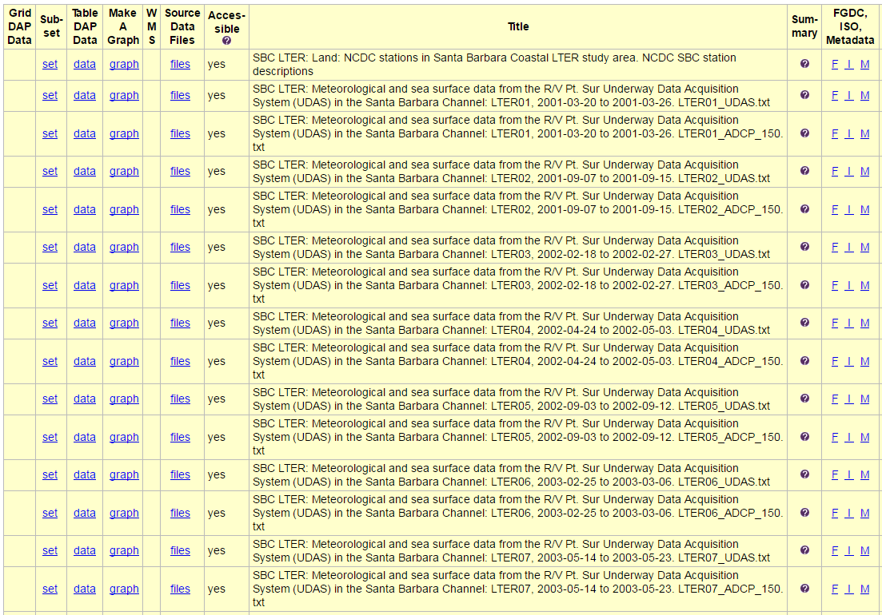
A Bridge
One can easily envision one ERDDAP with NOAA/USGS datasets and KNB/EML datasets offering a consistent way to search for and access all ecological/environmental datasets.

Slide 21
What's Next?
Work with people using EML / tabular datasets to set up an ERDDAP and add datasets.
Call or email me! Let's talk!

Slide 22
Thank you! Questions? Comments? Suggestions? Want to work on this? email bob.simons@noaa.gov Give ERDDAP a try! http://coastwatch.pfeg.noaa.gov/erddap/

