Slide 1
Subsetting In ERDDAP
ERDDAP
data
Your Favorite Client Software
Bob Simons
DOC / NOAA / NMFS / SWFSC / ERD
Monterey, CA
bob.simons@noaa.gov
Notes:
Hello. I'm Bob Simons, the author of ERDDAP.
Thank you very much for coming to this session and this talk.

Slide 2
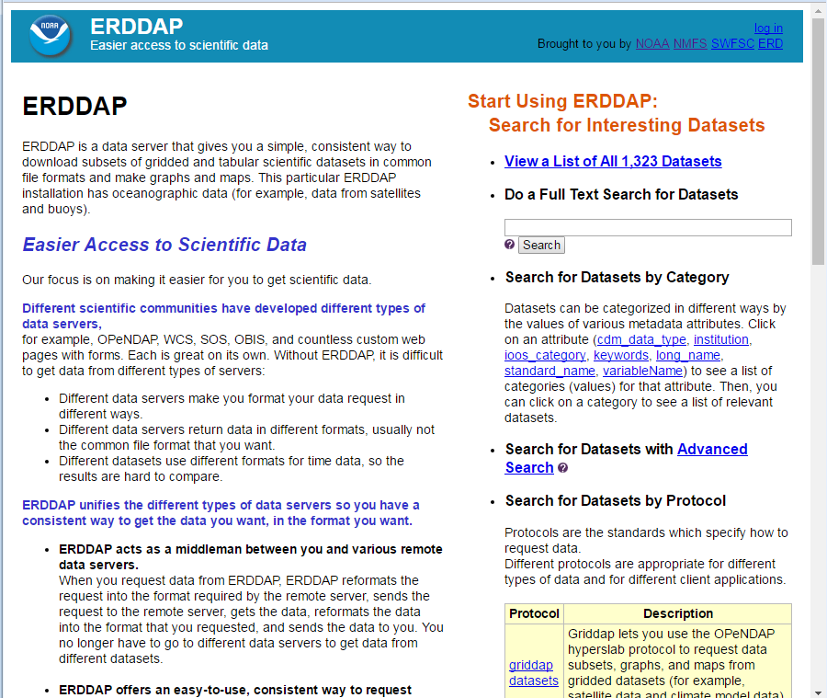
Notes:
So that you have the context for this talk, here's a super quick overview of ERDDAP.
ERDDAP is a data server. It is reusable, Free, and Open Source software.
It has been installed at more than 70 institutions in at least 10 countries
and is on NOAA's list of recommended data servers.
The ERDDAP homepage has a description of ERDDAP on the left
and several ways to search for datasets on the right.
I'll enter sst in the search box...

Slide 3
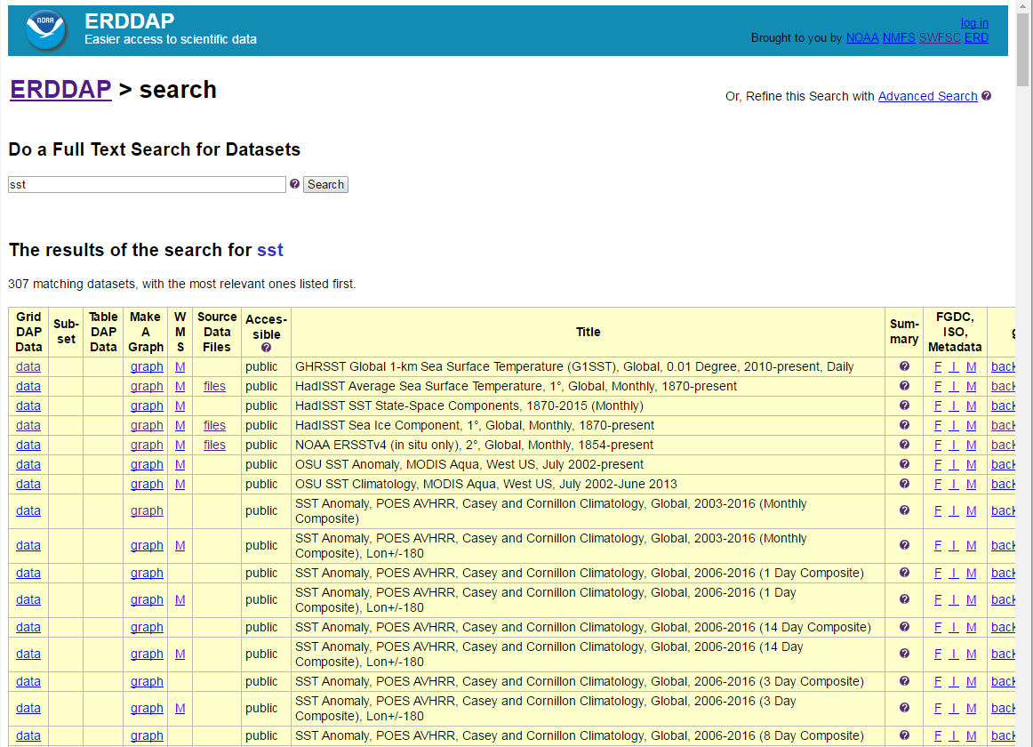
Notes:
and I get a list of relevant datasets, with the most relevant at the top.
All of the search options lead to a list of datasets
which shows ways you can access the dataset (on the left),
the dataset titles (in the center),
and some information about the dataset (on the right).

Slide 4
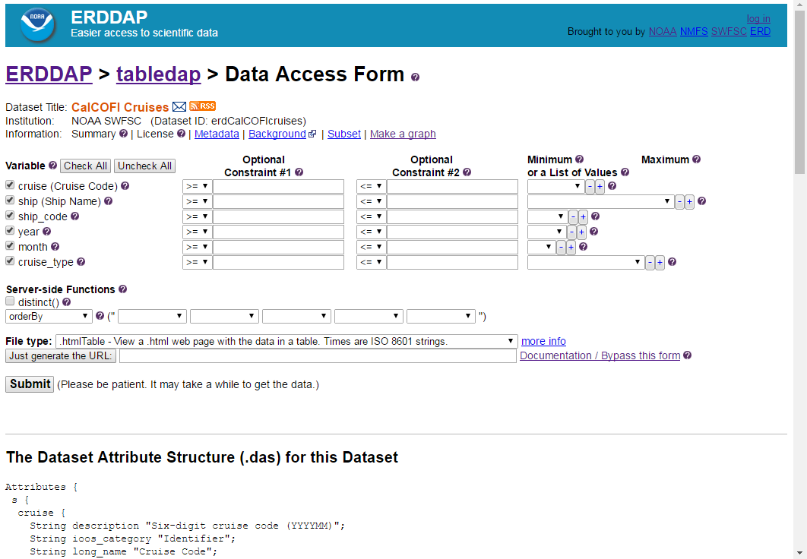
Notes:
The "data" links lead to an OPeNDAP-style Data Access Form
so you can request a subset of data.
ERDDAP deals with a given dataset as either
a gridded dataset (a collection of multidimensional arrays, e.g., level 3 or 4 satellite or model data)
or a tabular dataset (with a database-like table of columns and rows,
but this also works for the CF DSG data models).
A unique feature of ERDDAP is that you can specify the response file type
(any of 25 different types)
in order get the data in the format that is easiest for you to work with.
This talk is mostly about the JSON variations among all those file types.

Slide 5
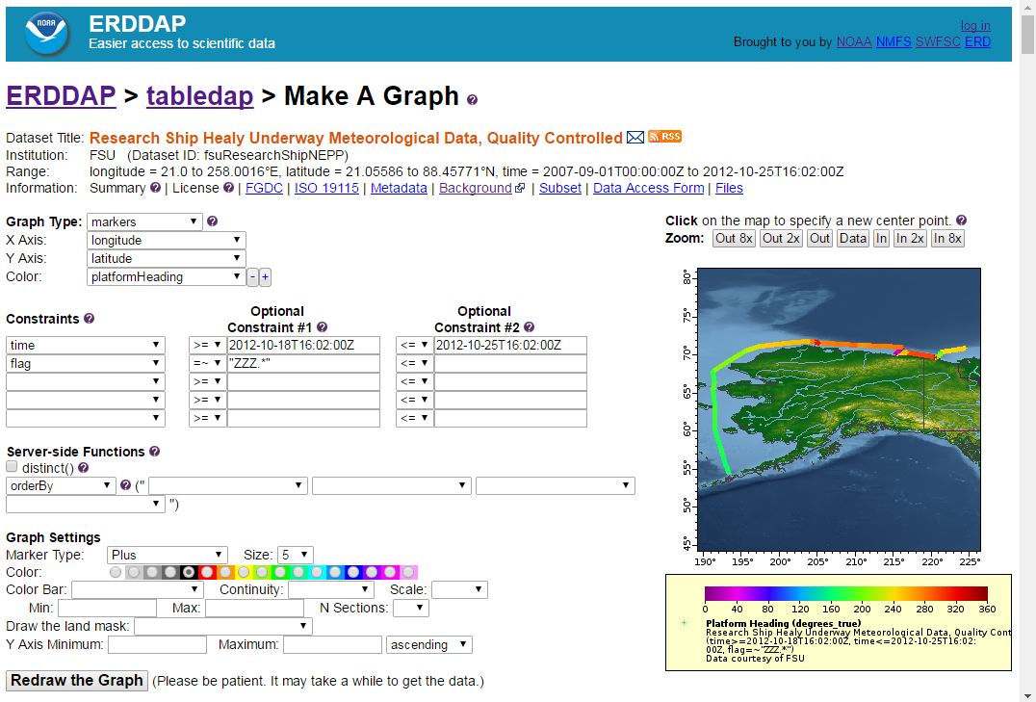
Notes:
There are also Make A Graph web pages for all datasets,
so you can create custom graphs and maps.

Slide 6
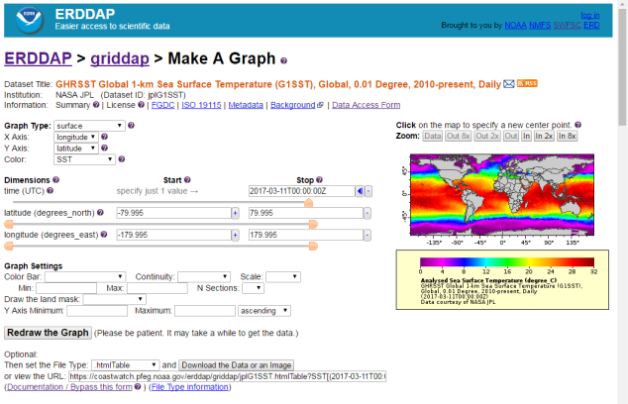
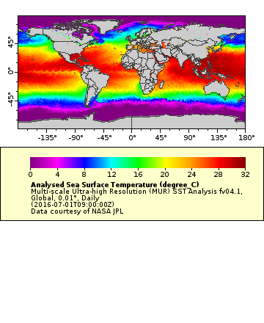
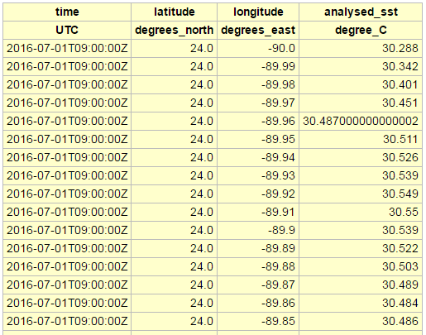
ERDDAP's web applications are built on ERDDAP's web services.
Web Applications - a web page with a form
(for humans)
RESTful Web Services - a single request URL specifies an entire request
(for computers)
URL
URL
Notes:
Web Applications (a web page with a form) are great for humans with a browser,
but aren't suitable for big tasks.
Imagine having to make 1000 requests by hand!
With a RESTful Web Service,
a single request URL using a standard protocol like OPeNDAP specifies an entire request.
So it is easy to automate with computer programs and scripts.
It's easy to build web applications on top of web services.
So that's what ERDDAP does.
Everything in ERDDAP has a web application (a human-friendly web page)
which uses an underlying web service (which is script-friendly). You can use either one.
It's easy to build other web services on top of web services.

Slide 8
2
3
1
4

Slide 9
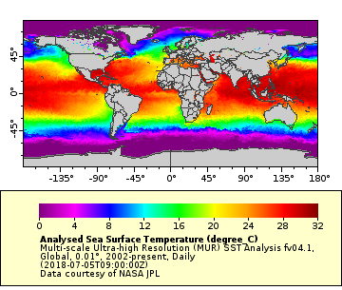
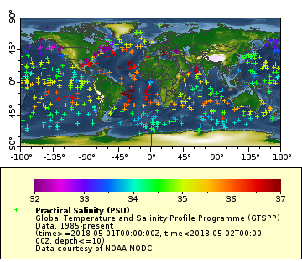
Aggregation
Users usually want aggregation.
Gridded Data
Tabular (In-situ) Data
Aggregation highlights the need to be able to select a subset.
Notes:
One more thing before I talk about subsetting.
Let me say why subsetting is so important.
Well, because users often just want a portion of a dataset, so it is faster and more efficient to get just that portion. For example, a user might just want data for the Gulf of Mexico. Why download a global file when you just want 1% of it?
Aggregation highlights the need for subsetting.
Users want aggregation.
For gridded datasets, when users search a catalog for datasets,
it is far more convenient to find 1 dataset (with a time axis),
than 10,000 datasets (one per granule).
And it is then far more convenient for users to make 1 request to that 1 dataset,
instead of some huge number of requests to some huge number of granules.
Similarly, for tabular datasets, when users search a catalog for datasets,
it is far more convenient for users find
1 dataset (with trajectory and profile variables),
instead of 100,000 datasets (one per trajectory)
or 32,000,000 datasets (one per profile -- which is how the data is distributed).
And it is then far more convenient for users to make 1 request to that 1 dataset,
instead of some huge number of requests to some huge number of datasets.
So, aggregation highlights the need to be able to select a subset.

Slide 10
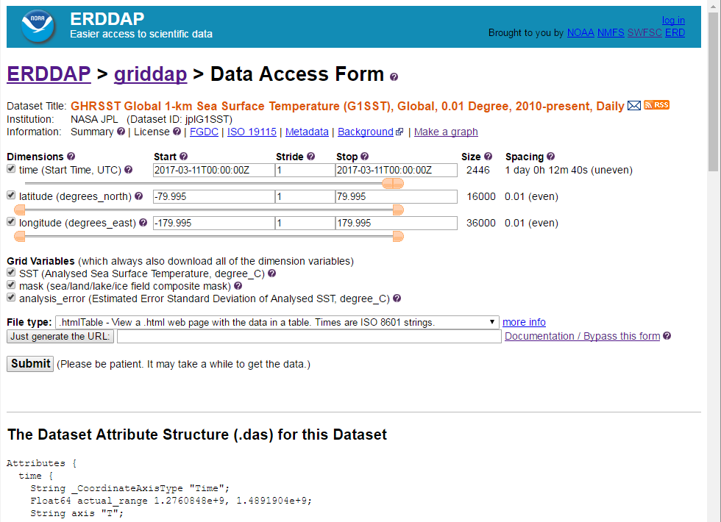
Requesting Gridded Data
(OPeN)DAP standard, plus extensions
Notes:
Here's the ERDDAP web page for requesting a subset of a gridded dataset.
A gridded dataset has dimensions and related 1D dimension variables
and grid variables that all of those dimensions.
The options on the web page reflect the options of the underlying web service.
If fact you can request the URL that the web page will send to ERDDAP
with the "Just generate the URL" button.

Slide 11
Gridded Data Request URLs
A RESTful URL specifies an entire request: dataset, response file type, subset: http://coastwatch.pfeg.noaa.gov/erddap/griddap/jplMURSST41.html ?analysed_sst[(2016-07-01T09:00:00Z)][(-89.99):1:(89.99)][(-179.00):1:(180)]
Special file types: .html (Data Access Form), .graph (graph form), .fgdc, .iso19115, .das, .dds
Data file types: .asc, .csv, .esriAscii, .json, .htmlTable, .mat, .nc, .odvTxt, .tsv, ...
Image file types: .geotif, .kml, .pdf, .png, .transparentPng
Notes:
Most people are familiar with THREDDS and its use of OPeNDAP-style
requests for multidimensional gridded data.
But most people don't know that OPeNDAP has another whole section
for dealing with what it calls sequences, but which I'll call tabular data.
So ERDDAP treats datasets as either multidimensional gridded datasets,
or as tabular datasets.
In both cases, a RESTful URL specifies the entire request.
For gridded data, the request URL has ... [parts of request]
ERDDAP supports standard OPeNDAP request which use index values for the dimensions.
But, in addition to that, if you surround the values with parentheses,
you can specify actual dimension value in the units of the dimension.
So here's a specific time value, a start and stop latitude value and
a start and stop longitude value.
... [file types]
... so users can make customized graphs and maps.

Slide 12
Grid Subsetting Details
(OPeN)DAP
var1[constraints],var2[constraints],...
varName[index]
varName[startIndex:stopIndex]
varName[startIndex:stride:stopIndex]
and fileType
ERDDAP (but soon DAP)
varName[(startValue):stride:(stopValue)]
varName[0:stride:last]
varName[last-3:stride:last] //index
varName[(last-3):stride:last] //value
varName[(last-4days):stride:last]
FileType: .asc or .dods (OPeNDAP) or ~40 other fileTypes

Slide 13
Requesting Tabular (In-situ) Data
(OPeN)DAP standard, plus extensions. Very much like SQL's WHERE.
Notes:
Here's the ERDDAP web page for requesting a subset of a tabular dataset.
A tabular dataset can be thought of as a database-like table of data
with columns that each hold one type of information
and rows for each observation.
ERDDAP treats all of the CF Discrete Sample Geometry-type datasets as tabular datasets.
That includes timeseries, profiles, trajectories, etc.
As before, the options on the web pabe reflect the options of the underlying web service.
And, as before, you can request the URL that the web page will send to ERDDAP
with the "Just generate the URL" button.

Slide 14
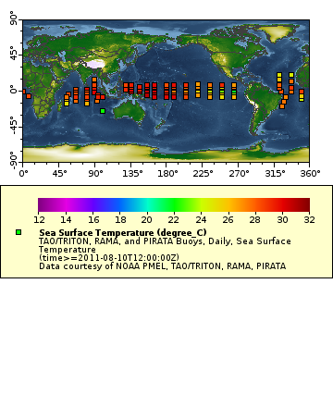
Tabular Data Request URLs
A RESTful URL specifies an entire request: dataset, response file type, subset: http://coastwatch.pfeg.noaa.gov/erddap/tabledap/pmelTaoDySst.html ?longitude,latitude,T_25,time&time=2011-08-10T12:00:00Z
Special file types: .html (Data Access Form), .graph (graph form), .fgdc, .iso19115, .das, .dds, .subset
Data file types: .asc, .csv, .esriCsv, .htmlTable, .geoJson, .json, .mat, .nc, .ncCF, .ncCFMA, .odvTxt, .tsv, .xhtml, ...
Image file types: .geotif, .kml, .pdf, .png, .transparentPng
Notes:
Similarly, for tabular datasets, a RESTful URL ...
You may have noticed that an OPeNDAP request for tabular
is very much like a request to a database using SQL, the language for database requests.
SQL requests have SELECT these variables FROM this table WHERE these things are true.
This is particularly convenient for ERDDAP when the source dataset is a database,
because ERDDAP can easily translate an ERDDAP request into a SQL request
to get data from the database.
As with requests to gridded datasets, ERDDAP supports lots of file types.
There are Special file types ...

Slide 15
Tabular Subsetting Details
CSV list of variables: e.g., station,time,wtemp
Constraints: format: &variable operator value Operators: =, !=, <, <=, >, >=, =~"aRegularExpression" E.g., &wtemp>16&time>=2018-07-06T00:00:00Z E.g., &station=~"(SFO|MNTRY|LJL)" E.g., &time=max(time) // &time>=max(time)-3hours
Filters: DAP "server-side functions", ERDDAP-specific:
&distinct()
&orderBy("station,time")
&orderByMax("station,time") //or orderByMin
&orderByMinMax("station,wtemp")
&orderByCount("station")
&orderByClosest("station,time,2hours")
&orderByLimit("station,100")
&units("UCUM") or &units("UDUNITS")
FileType: .asc, .dods (OPeNDAP) or ~35 other file types
Notes:
...
max() is an ERDDAP extension to the DAP standard.
...

Slide 16
Future
More filters
Notes:
ERDDAP is an on-going project.
New features are continually being added in order to help with user's needs.
So it is very likely there will be additional filters
to do other types of processing on the server.

Slide 17
Read about ERDDAP and try it out http://coastwatch.pfeg.noaa.gov/erddap/ Download and install ERDDAP http://coastwatch.pfeg.noaa.gov/erddap/download/setup.html Thank you! bob.simons@noaa.gov

