Slide 1
ERDDAP in 2018
ERDDAP
Your Favorite Client Software
Bob Simons
DOC / NOAA / NMFS / SWFSC / ERD
Monterey, CA
bob.simons@noaa.gov
Notes:
[say the 1) 2) 3) numbers]
Hi. I'm Bob Simons, the author of ERDDAP.
ERDDAP is a free, open-source, data server
that is on NOAA's list of recommended data servers.
It has been installed and used at more than 65 organizations around the world.
ERDDAP's goal is to give users easier access to scientific data.

Slide 2
2
3
1
4
Notes:
(This is the only high-density slide. I promise.)
ERDDAP is a middleman data server.
It can get data from lots of different types of local datafiles, databases,
and remote data services.
It can generate many types of data files on-the-fly in response to data requests.
1 ...
2 ...
3 ...
4 ...
Thus, it makes the heterogeneous world of data sources appear
as a homogenous site with lots of data.

Slide 3
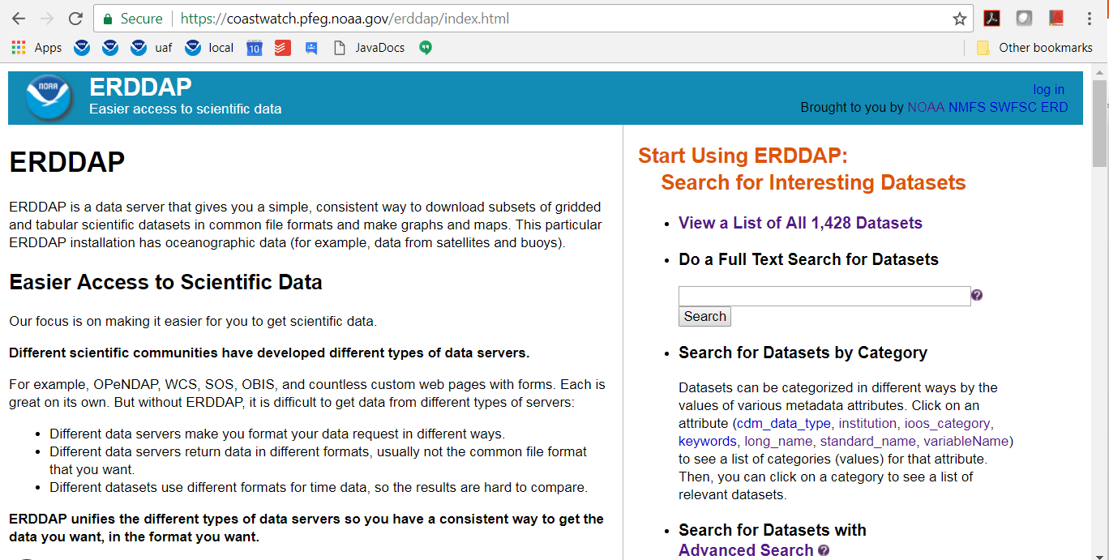
ERDDAP
Notes:
To users, ERDDAP just looks like a data server with
lots of datasets.
Whether a given dataset's data is local or remote is
hidden from users.

Slide 4
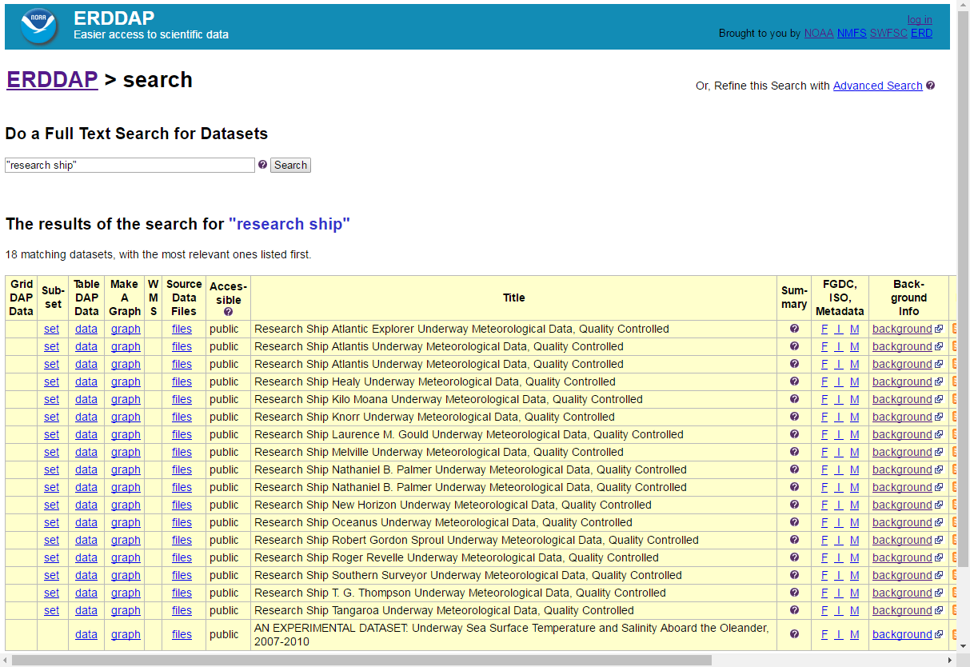
Catalog Searches
Notes:
ERDDAP offers
free-text catalog search, search by category, and advanced search
(which lets you specify time, latitude, and longitude bounds).

Slide 5
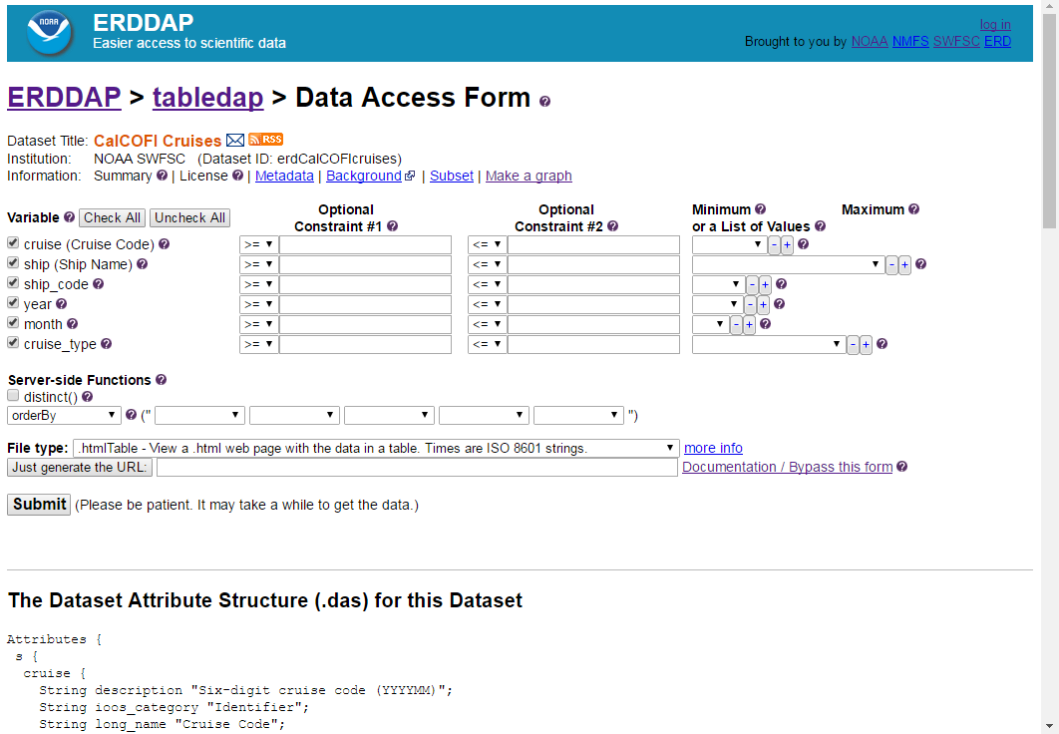
Data Access Form
Notes:
You can then download a subset of a dataset via
a web page or by submitting a RESTful request
to ERDDAP's OPeNDAP web service.
A RESTful request specifies the entire request in one URL,
including the response file type.
RESTful requests are really handy. You can make requests from lots of other programs,
for example, R, Matlab, IDV, IDL, ODV,
or from a script that you write.
And you can make dynamic web pages that request data
in json files
and then do something with the data on the web page.

Slide 6
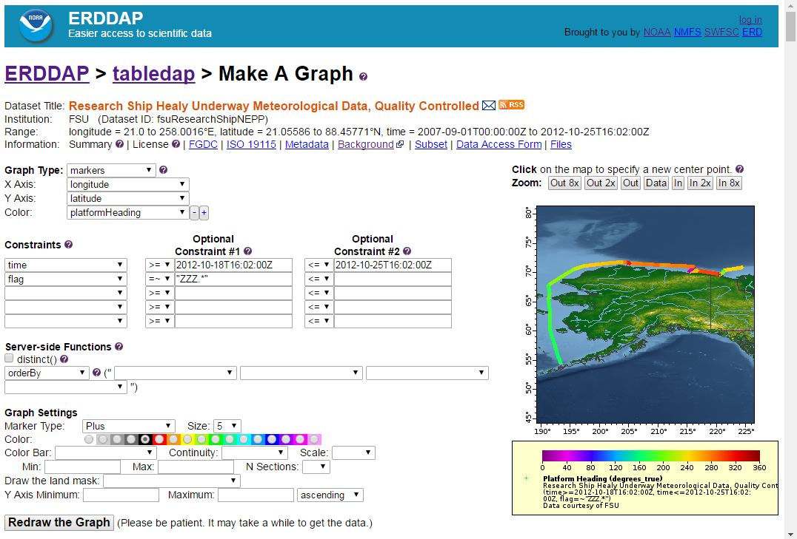
Make A Graph
Notes:
In addition to having web pages and web services for downloading subsets of datasets,
ERDDAP has a system of web pages and web services
for making custom graphs and maps for each dataset.

Slide 7
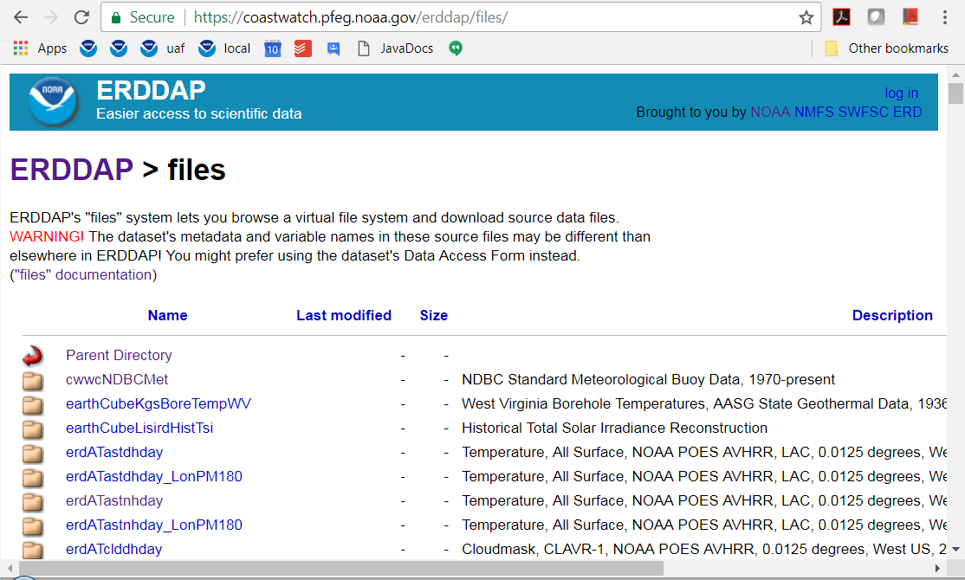
"Files" System
Notes:
And ERDDAP has a "files" system so users can download a dataset's original source files.

Slide 8
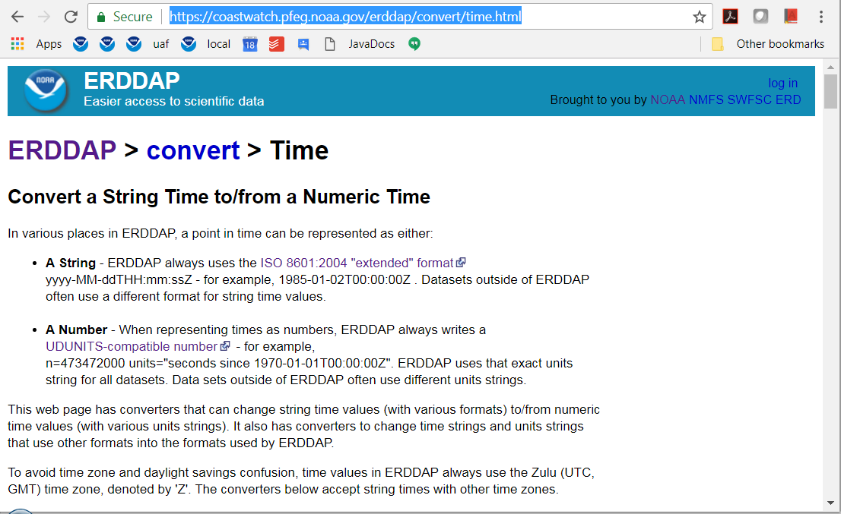
Converters
Notes:
ERDDAP also has several tools called "Converters" that offer
useful related services.
This one converts String times to or from numeric times.
Like everything in ERDDAP, the converters can be used
by humans (via web pages),
and computer-to-computer (via a RESTful web service).

Slide 9
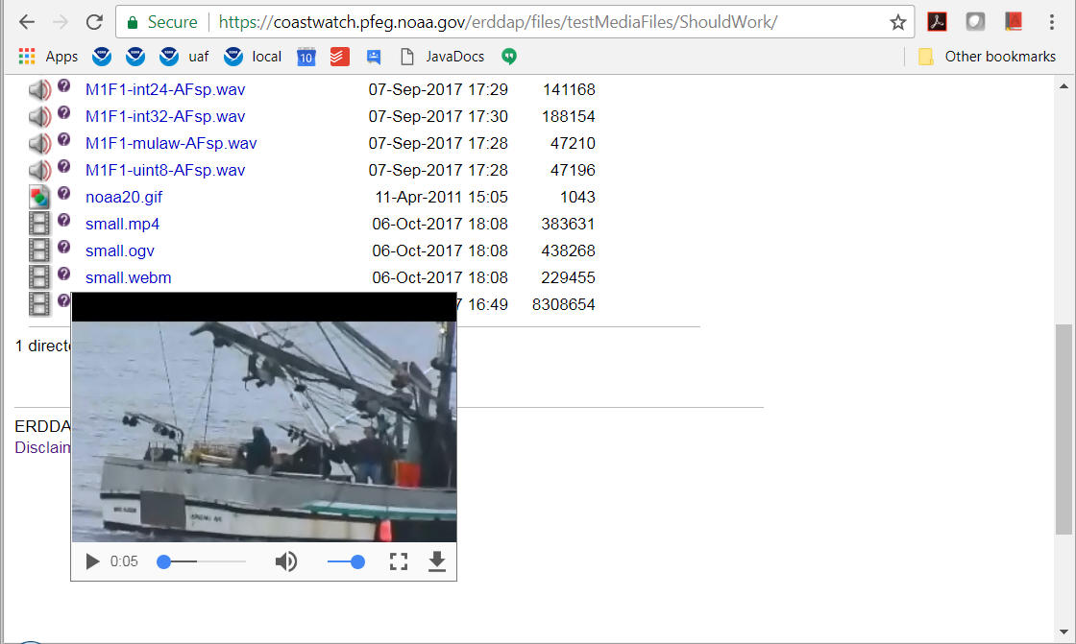
HTML 5 and Media Files
Notes:
All of those features have been available in ERDDAP for several years.
One of the big new features in the latest release of ERDDAP is:
ERDDAP finally switched to HTML 5
and has a slightly modernized look-and-feel.
The switch to HTML 5 allowed for a few related changes:
The main one is new support for media files:
Now, in the "files" system, if you hover over the (?) icon
for an image, audio or video file,
ERDDAP shows a player for that file in a pop up window.

Slide 10
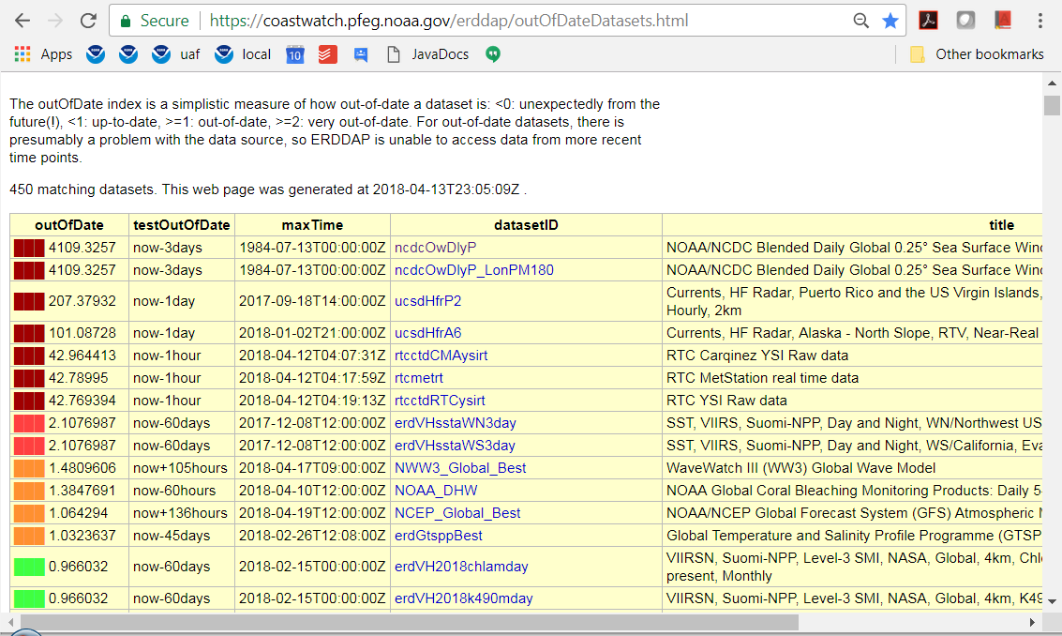
"testOutOfDate"="now-2days"
Notes:
Another new feature, of interest to ERDDAP administrators and users,
is a system for monitoring if near-real-time datasets
aren't as up-to-date as they should be.
If the administrator adds a global attribute "testOutOfDate",
specifying when the dataset is considered out-of-date,
ERDDAP will generate a web page like this showing all the datasets
with that attribute, ranked by how out-of-date they are.
It's color coded: red for really out-of-date,
orange for a little out-of-date, and green for okay.
This has been very useful to me because it quickly and
automatically does a ton of work
that is really cumbersome to do by hand.
Here it is pointing out NCDC's Blended Ocean Winds dataset,
that normally has data for now-2days,
suddenly only had data through 1984!
and so is way out-of-date!
So then you know what problems to follow up on.

Slide 11
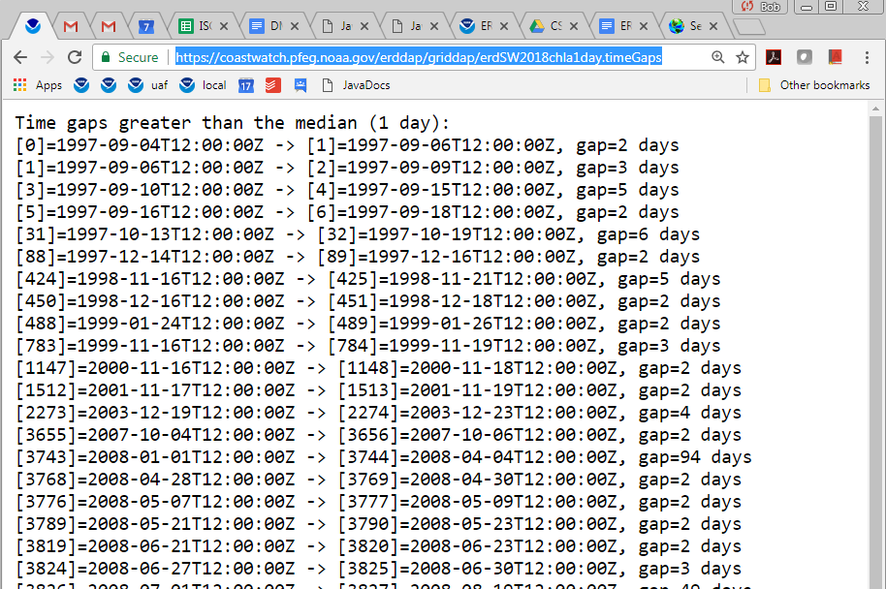
.timeGaps
Notes:
Another new feature, again useful for both administrators and
users, is the new .timeGaps file type for gridded datasets.
When you make this request,
ERDDAP figures out the median time between time points
for the dataset, then generates a list of times
where the gap is larger than the median.
This makes it easy to identify missing files from a collection.
Users always expect that, for example,
a daily dataset will have data for each day.
They are surprised if and when that isn't the case.
You may be, too!
With this system, it is easy to see which files are missing,
so you can try to figure out why.

Slide 12
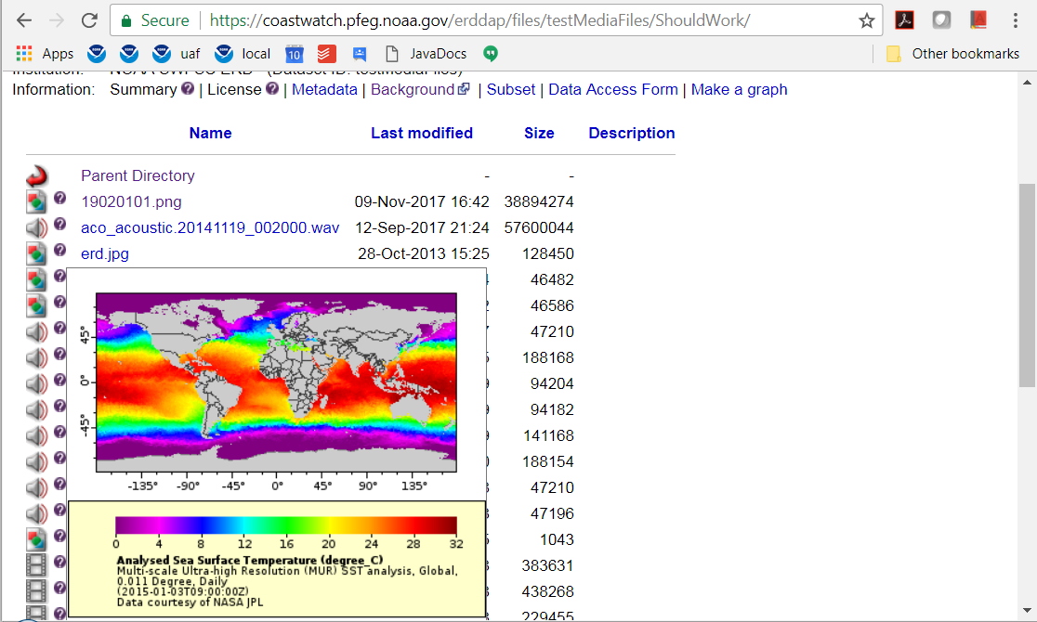
ERDDAP v2.00
Notes:
ERDDAP version 2.00 is coming soon.
It's jumping to version 2.00 partly to celebrate ERDDAP's
10th birthday since it first became publicly downloadable
with the release of version 1.0 in May 2008.
But more than that, for the first time,
ERDDAP will have a system for data ingest.
With this system, an authorized sensor, QC script,
or human author, will be able to contact
a URL that inserts data into a dataset.
The system is very fast, efficient, robust and fault tolerant.
The system easily supports adding up to
1000 rows of data per second.
The system has some unique features
that aren't in other data ingest systems,
notably, very fine-grained versioning of the dataset --
to the millisecond.
This is useful for data management,
as it allows the data to be changed,
but keeps a complete log of what changes were made,
and by whom.
The fine-grained versioning of the dataset allows for
reproducible science.
That's coming very soon.

Slide 13
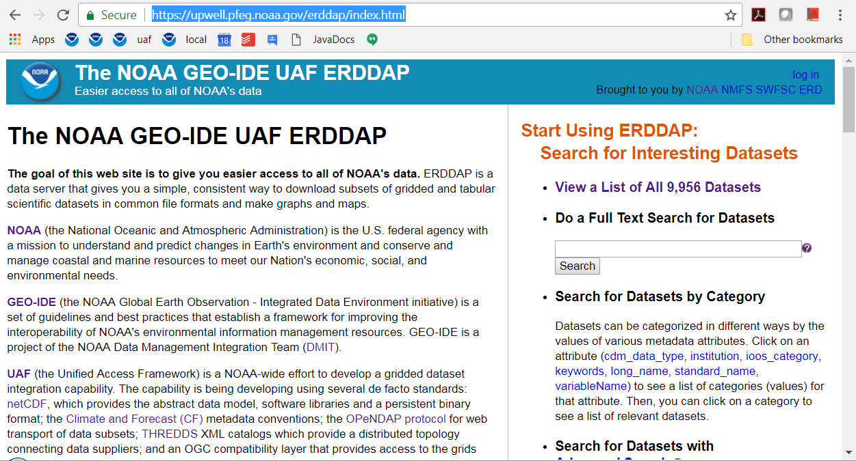
ERDDAP and UAF
Notes:
This is a joint session, UAF and ERDDAP,
partly because I made and maintain a UAF ERDDAP
[point to image]:
an ERDDAP installation with all of the datasets from the UAF THREDDS clean catalog and some other datasets.
Like the UAF THREDDS catalog, it is a work-in-progress
attempt to offer all of NOAA's data
in a consistent, unified way. Currently it has about 10,000 datasets.
I generated most of these datasets by running a
THREDDS catalog crawler (that comes with ERDDAP)
and having it generate ERDDAP datasets
from all of the datasets that it finds in the UAF THREDDS catalog.
None of the data for those 10,000 datasets is
on the server running that ERDDAP.
All of the data is from remote sources,
accessed via web services --
that incudes numerous NOAA THREDDS and ERDDAP servers
and even some NASA servers.
That's the beauty of a distributed data system of web services
with a data server like ERDDAP sitting on top.
When one of those remote datasets is updated
(e.g., with a new data file),
the new data is available to users of this ERDDAP.
I really like the UAF project.
It is the fastest, easiest, most efficient way I know of
to work toward making all of NOAA's data accessible
in a consistent, interoperable way.
But this approach only works if each group in NOAA (each "stovepipe of excellence" as Jeff DLB says) does its part.
That means:
* Every group needs to use NcML or NCO to improve the dataset's CF and ACDD metadata * Every group needs to set up a THREDDS to make the data accessible by web services. * That gives everyone, humans and computer programs, a consistent, interoperable way to access the data.
I encourage all NOAA groups to follow this approach
and work with the UAF project.
As I said, it is the fastest and easiest way for us
to make all of NOAA's data easily accessible
to anyone who wants it.

Slide 14
Read about ERDDAP and try it out: https://coastwatch.pfeg.noaa.gov/erddap/ Or, try out the UAF ERDDAP: https://upwell.pfeg.noaa.gov/erddap/ Download and install ERDDAP: https://coastwatch.pfeg.noaa.gov/erddap/download/setup.html Thank you! bob.simons@noaa.gov
Notes:
That's all.
...

