Slide 1
New Features in ERDDAP for Image, Audio, and Video Data
ERDDAP
Your Favorite Client Software
Bob Simons
DOC / NOAA / NMFS / SWFSC / ERD
Monterey, CA
bob.simons@noaa.gov
Notes:
[say the 1) 2) 3) numbers]
...

Slide 2
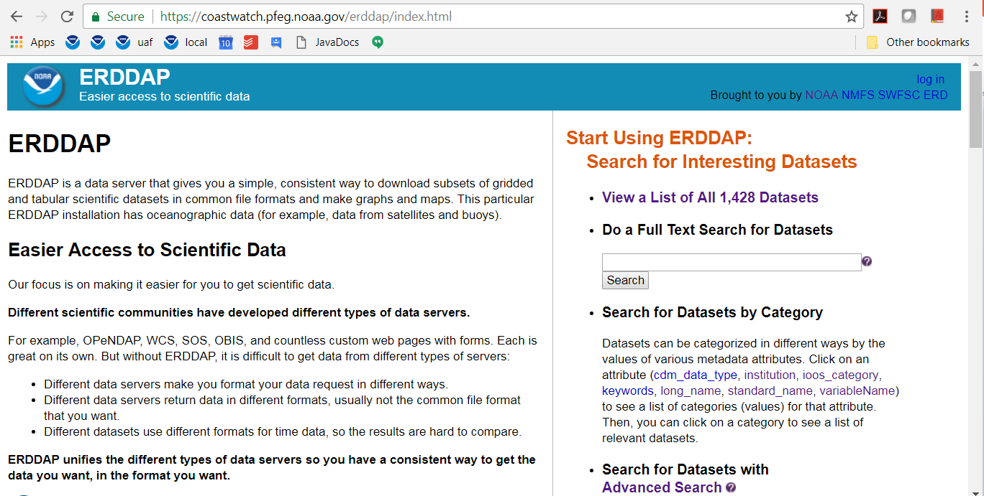
ERDDAP
Notes:
ERDDAP is a free, open-source, data server that is on
NOAA's list of recommended data servers.
It has been installed and used at more that 65 organizations
around the world.
ERDDAP's goal is to give users easier access to scientific data.
"Data" has traditionally been data files
with arrays of strings and numeric data.
ERDDAP handles gridded data (like satellite and model data),
and tabular data (like in-situ data or anything that can be
stored in a database-like table).
Now, there are new features in ERDDAP that make it
easier to work with image, audio, and video files.

Slide 3
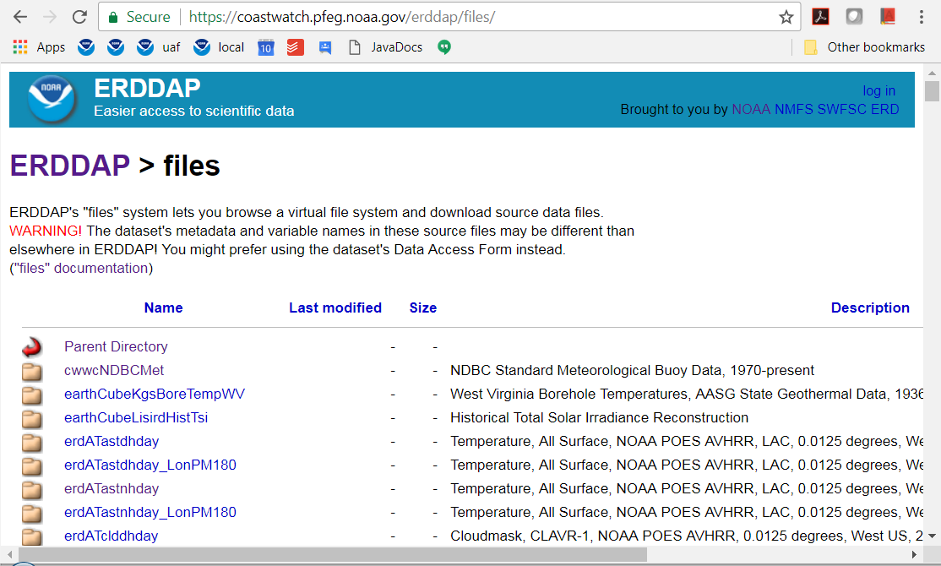
"Files" System
Notes:
For many years now, ERDDAP has had a "files" system.
It shows a virtual directory for each dataset where the administrator
has specified that the source files
should be made directly accessible to users.

Slide 4
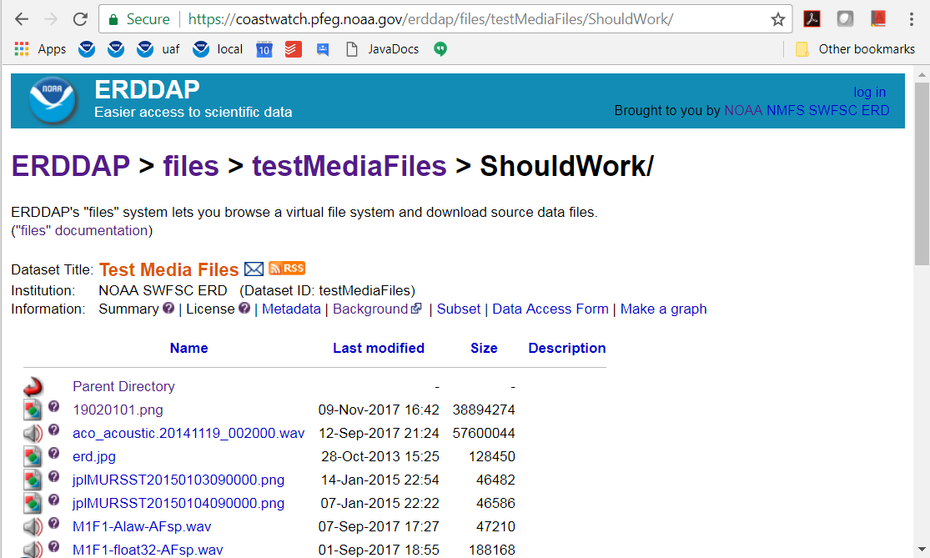
EDDTableFromFileNames
Notes:
And for many years, there has been a dataset type
that lets you make any type of file
(even non-"data" files like image, audio and video files)
directly accessible to users via this system.

Slide 5
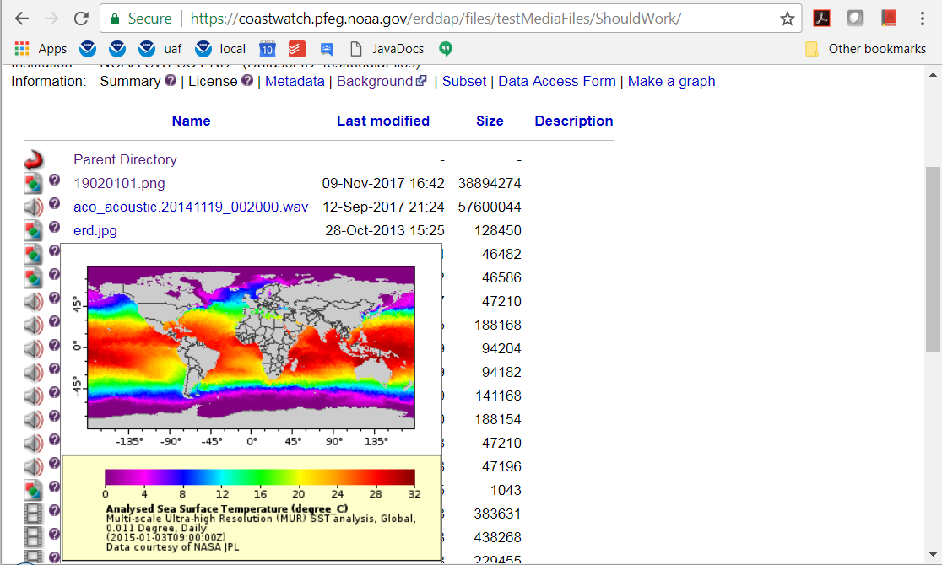
Hover Over Image File
Notes:
Starting with the most recent release of ERDDAP,
if you hover over the question mark icon for an image file,
ERDDAP shows you the image in a pop up window.
The NOAA library has lots of great historic image files,
but it's a multistep process to look at each.
I think it would be great if collections like that
were available in a more direct way via ERDDAP.

Slide 6
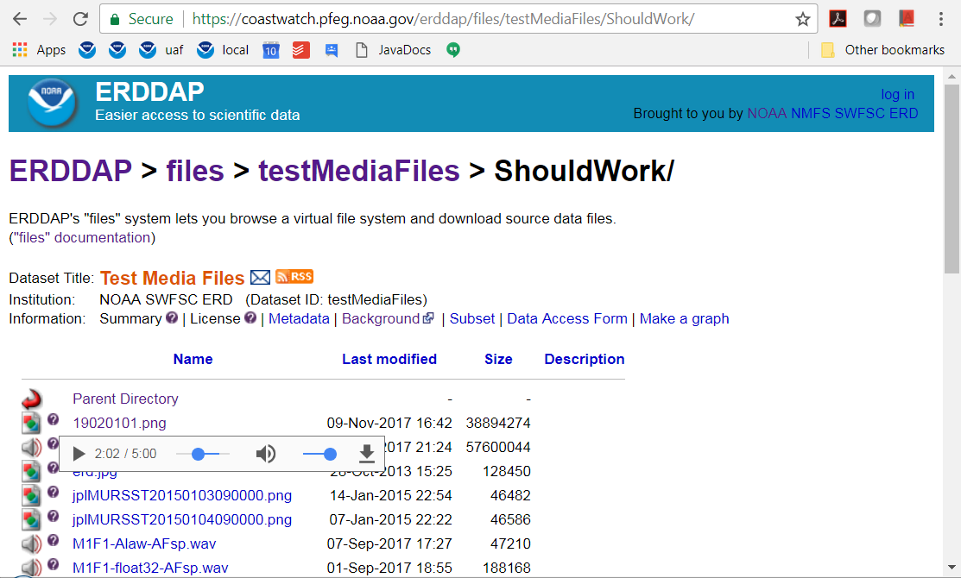
Hover Over Audio File
Notes:
And now, if you hover over the question mark icon
for an audio file,
ERDDAP shows an audio player for the file in a pop up window.

Slide 7
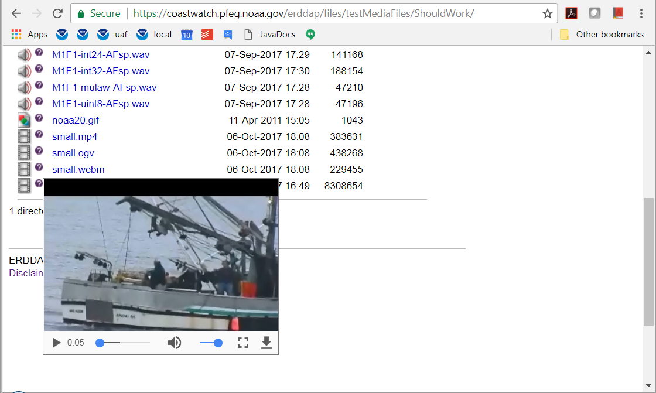
Hover Over Video File
Notes:
And now, if you hover over the question mark icon
for a video file,
ERDDAP shows a video player for the file in a pop up window.
For all of these players and viewers,
normally if you put say 20 of them on a web page,
the browser would immediately try to load all 20 media files,
which might take minutes.
But ERDDAP uses deferred load for them.
So a given file only loads when the user requests one of them.
So the system works quickly and efficiently.
A nice feature of these viewers is:
you can just dump a bunch of files
(hopefully with descriptive file names) in a directory.
I'll also mention:
You could make a dataset of annotations of video or audio files
by creating and maintaining a csv file, by hand,
which has columns for
lat, lon, time, file name, timepoint in the file, author, annotation.
You could have a row for each annotation.
Then you could make an ERDDAP dataset from the .csv file.
Then users could search for annotations with specific words,
e.g., a specific whale species
and search for sightings in a certain time range
or geographic range.
The results would show the full matching annotations
and have a link to the related media file.
A custom system (like the OER Video Portal) could beat
ERDDAP's simple system of viewers.
But it might still be useful to use ERDDAP's system
to make the files available and build the other services
on top of ERDDAP's services.

Slide 8
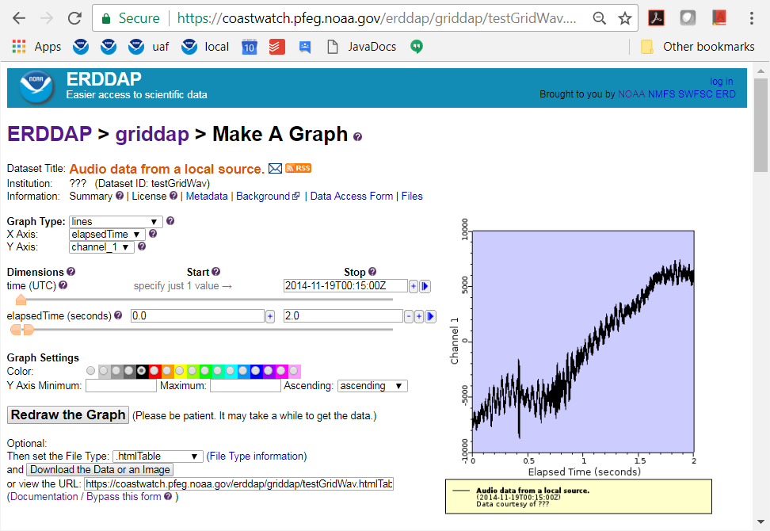
Audio Files as Data Files
Notes:
Also new, ERDDAP has two new dataset types
which let you create datasets from audio files.
The dataset's data are the numbers that make up the waveform.
These datasets can read .wav and other audio files.
And they can write subsets of the dataset as .wav audio files.

Slide 9
Read about ERDDAP and try it out http://coastwatch.pfeg.noaa.gov/erddap/ Download and install ERDDAP http://coastwatch.pfeg.noaa.gov/erddap/download/setup.html Thank you! bob.simons@noaa.gov
Notes:
You can read about ERDDAP and try it out at the top URL.
You can download and install it from the second URL.
That's all. For once I didn't run overtime.
Thanks for listening. If you have any questions, let me know.

