Slide 1
A Distributed System of Web Services (Faster, Easier, Less Expensive) (Or, why I was happy 4 years ago.)
Bob Simons
DOC / NOAA / NMFS / SWFSC / ERD
Monterey, CA
bob.simons@noaa.gov
Notes:
[say the 1) 2) 3) numbers]
Jeff, thanks for having this session and for letting me speak.
The original topic for this session was:
where should we be in 5-10 years?
So my talk looks back at the last 4 years
and where we could have been now,
And then looks to where we could be as soon as next year.

Slide 2
The Goal: Easy Access to All NOAA Data
Findable via a catalog
Understandable via metadata
Accessible via web services
Notes:
I think the goal is: Easy Access to All NOAA Data
I want every dataset to be:
* Findable via a catalog
* Understandable via metadata
* Easily and freely accessible via web services, (that is, computer to computer access), notably via OPeNDAP

Slide 3
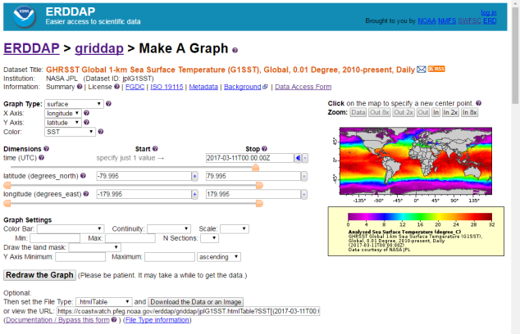
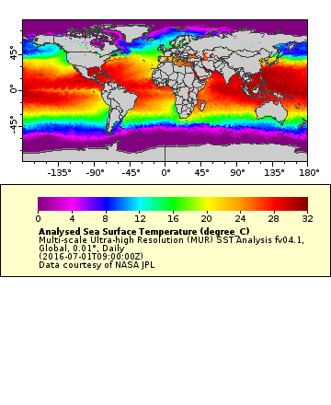
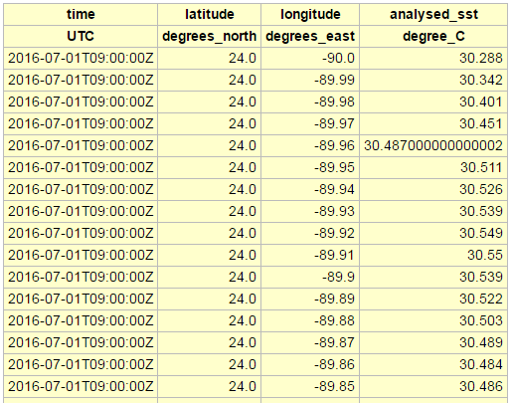
Build (fancy) stuff on top of the web services.
Other (fancy) stuff uses it: web applications (web pages with forms, for humans), catalogs, scripts, WMS servers,
R, Matlab, Python Notebooks,
ArcGIS, SOTO, ODV, IDV, IDL,
and other services!
RESTful Web Services (computer to computer) - a single request URL specifies an entire request
URL
URL
Notes:
Why the emphasis on web services?
Because :
* If we build a good foundation of RESTful Web Services, (where one URL specifies an entire request)
* we, or anyone else, can easily build
all kinds of other fancy stuff on top of the web services,
including:
web applications
(which are web pages with forms, for humans), catalogs, fancy stuff like NASA's SOTO,
and even other web services.
That's what web services are for.

Slide 4
The Last 4 Years: The Slow, Difficult, Worse Approach
Human Users Only
NOAA Catalog
Files or Shopping Cart (maybe unaggregated in THREDDS)
1) ISO 19115 (by hand)
2) Data (maybe with CF + ACDD Metadata)
Notes:
So what have we done for the last 4 years?
Many groups have taken a slow, difficult approach that yields a worse result.
1) Their main effort has been to populate the NOAA catalog (a good thing)
by making the ISO 19115 documents by hand,
which is a difficult and time consuming way to do it.
They encourage lots of people to go training sessions,
buy software to edit XML files,
become ISO experts (which is not easy)
and then work to handcraft the ISO files (which is hard).
What an inefficient approach!
2) Many of these groups do little work on the actual data:
The metadata remains insufficient.
The data is offered as files users can download,
or worse, a shopping cart that they can request a few files from,
wait several hours,
then download a .zip file with the requested files.
If they do offer the data via web services like THREDDS,
they usually offer the data unaggregated:
so one dataset appears as 5000 granules,
instead of as one dataset.
Worse, they now have the metadata in two places
which are out of synch and hard to get in synch.
Worst of all, these access methods only support human users.
So there is no way to write a script to download the data.
And there is no way to connect other software programs
to access the data.
Really? In 2018?
The late 1990's are calling [mimic phone call]: they want their data distribution plan back.

Slide 5
Web Services (Faster, Easier, Better)
Human Users and Client Software
NOAA Catalog
Web Services (THREDDS and/or ERDDAP)
ncISO
ISO 19115
1) Data with CF + ACDD Metadata (NCO, NCML?)
Notes:
What I'm proposing is nothing new.
Many groups (like ESRL) have done this.
The plan is:
1) Start with the data.
Improve the CF and ACDD metadata associated with the data.
You can use NCO, an underappreciated tool, to modify the files.
Or, if you don't want to change the original files,
you can use NCML, another underappreciated tool, to describe a set of changes
that are applied on-the-fly when the file is read.
Improving the metadata is the one time-consuming step in this approach.
It needs human effort. But once done, every other step is easy.
It is easy to get the data into reusable software like THREDDS and/or ERDDAP, that offers web services.
Then THREDDS and/or ERDDAP will automatically generate the ISO documents via the built-in ncISO, yet another underappreciated tool.
The NOAA catalog crawler can then harvest the ISO documents from the THREDDS and/or ERDDAP ISO Web Accessible Folder (WAF) and populate the NOAA catalog.
The user can then discover datasets via the NOAA catalog.
And the user can access the data via THREDDS or ERDDAP web applications and web services.
There are three huge advantages of this approach:
It's really fast and easy. The only significant effort is improving the CF and ACDD metadata via NCO or NCML, which isn't hard.
The metadata included with the data and the metadata in the ISO document are perfectly in synch and will never be out of synch.
The data is now accessible in a consistent way via web applications (which support human users) and web services (which support other client software).

Slide 6
A Distributed System of Web Services
NOAA is inherently a distributed system ("stovepipes of excellence").
Each site should offer their data and metadata via web services.
Anyone can build anything on top of that.
NOAA-wide system : Unified Access Framework (UAF)!
This solves all the problems.
Notes:
And I'm proposing (again, not a new idea)
that we build a distributed system of these web services.
* NOAA is already a distributed system.
We are inherently a distributed system. As Jeff DLB says, we have "stovepipes of excellence".
Instead of seeing this as a problem,
why not turn this situation to our advantage?
* Each site in NOAA (including NCEI) that creates and maintains data and metadata should offer their data and metadata via web services as I just described.
Hey! That's the EDM recommendation from about 4 years ago!
* Then, anyone can easily build anything on top of that.
We could even, easily build a NOAA-wide system.
* Hey! That's Unified Access Framework (UAF), a small EDM-based NOAA-wide effort to make all of NOAA's data accessible in a consistent and interoperable way via THREDDS.
So this approach shouldn't be new or surprising.
This solves all the problems by treating our current distributed system as an asset, not a liability, and by doing the work in the most efficient way.

Slide 7
I was happy 4 years ago.
We had everything we needed.
I thought this was the plan.
It's still the best plan.
Just Do It!
I could be happy again next year!
Notes:
[smile] I was happy 4 years ago
* because we had everything we needed to do this
* and because I thought this was the plan.
But many groups didn't do it.
It seems like the majority of datasets aren't yet
available via web services.
* It's not too late.
A distributed system of web services is still the best plan.
But it only works to the extent that each group (each stovepipe)
does its part.
* I say: life is short, time is of the essence, Just Do It.
We could have all of NOAA's data accessible by web services
next year!
* I could be happy again next year. That would be great!

Slide 8
Worrisome: The Big Data Project
Private sector! Profits! Yea! Good for them!
Equal protection?
Who do we work for?
Don't let BDP be an excuse.
What about our duty?
Taxpayers pay. Five companies reap?
Notes:
--- Short version:
My main point about the Big Data Project is:
I'm happy that the companies will host the data.
I hope they can profit from this.
Good for them.
But, for us, don't let the Big Data Project be an excuse for us to not do our job.
Our job is to make great data services that make all NOAA data freely and equally accessible to everyone.
If we do that, everyone, not just 5 huge companies, will be able
to access the data and do what they want with it.
---- Long version:
* Hey. If private companies can find new, profitable uses for NOAA data, that's great!
* But:
The US government shouldn't be favoring any one or any group,
let alone a few, officially blessed, huge companies.
US government employees shouldn't be doing work
specifically for these few huge companies.
I did a month's work to add support for Amazon Web Services.
I know other people have done much more.
Is that right?
* There is a very real danger that people will use the Big Data Project as an excuse not to do their job to offer great data services via NOAA servers.
I've already heard this from high up people.
* Our duty is to make the NOAA data distribution system great
and make the data equally accessible to everyone.
If we do that, any individual, any group, and
any company (not just the blessed five Big Data Project partners)
will be able to get the data and do anything they want with it.
And if the Big Data Project partners can then make money off of the data, good for them.
* Every taxpaying US citizen and taxpaying company paid for that data.
They all deserve free and equal access to it.
When the Soviet Union broke up, the government gave government assets
to a few well-connected people, who were then the oligarchs.
This was widely criticized in Russia and the West.
I'm having a hard time seeing how The Big Data Project is different.

Slide 9
Worrisome: A Cloudy Future?
Great for some things.
Not good for other things.
Inevitable? (Group Think?)
Good for NOAA? Maybe. Maybe not.
Done by the companies (BDP)? Their goals are different than our duty.
Done by us? (storage) cost?! It's no easier in the cloud than on our servers.
Notes:
My main point is about the cloud is:
The cloud offers a transformative solution to many use cases,
notably compute-intensive tasks with huge datasets. Great.
But, the cloud isn't the best system for all use cases and isn't inevitable for all of our data.
Beware of data storage costs and
of the added effort of accessing data stored on systems like S3.
And I fear NCEI is going to go straight from tape to cloud
and largely skip data services. We'll see.
--- Long version
* Having the data in the cloud is great and fundamentally better for some tasks, like processing or reprocessing entire datasets.
* So far, it's not so good for other things like basic data access:
S3 for example is okay if you want a whole granule,
but troublesome if you want a subset of a granule.
The tools we use, notably the netcdf libraries, work with files in directories, not buckets,
and the nature of S3 makes it hard to get around that.
* Is the move to the cloud inevitable? Maybe this is Group Think. As in, [questioningly] Everyone is saying it's inevitable so it must be inevitable. I think it's only "inevitable" if we make it so. I think it's worth thinking about whether it's a good idea. Or trying to figure out which things it's good for and which things it isn't.
* Is it good for NOAA? Maybe. Maybe for some uses and not for others.
It depends on how it plays out.
* If the work is being done by the companies (as with the Big Data Project), well,
Their goal is to make a profit -- fair enough.
Amazon, for instance, is serving the data via S3,
which is great for users who want to spin up compute instances
and analyze an entire dataset, but not good for other use cases, like requesting a subset. S3 is not a web service like OPeANDAP.
Our goal, our duty, is make the data available to everyone, freely and equally.
These are different goals.
* If the work is being done by us: keep an eye on the costs.
Cloud processing is cheap, especially if you just need it in bursts.
Cloud storage is relatively expensive.
And it is no easier to set things up on the cloud than to do it on our own servers.

Slide 10
A distributed system of web services is still the best way forward.
Use existing, reusable software.
Use NCML to add good CF and ACDD metadata to the data.
Use ncISO to create ISO 19115 documents.
Use THREDDS and ERDDAP to make the datasets accessible via web services.
Build everything else on top.
Embrace our existing, inherently distributed system.
This approach is fast, easy, efficient, less expensive, and great!
Just Do It!
Thank you! <bob.simons@noaa.gov>
Notes:
A distributed system of web services is still the best way forward.
Just Do It! (this year, please)
Thank you for listening.

